Slide 1

SafeHaven AI: Smart Elder Care : A Data-Driven Solution to Support

Slide 2
Agenda
1. About us
2. Problems
3.Solution
4.Raw data
5.Jyputer notebook
6. Pivot table
7.Dashboard
8.Dax Measurements
9.What am I asking for?
10.Conclusion
11. References

Slide 3
About us
SafeHaven AI offers a smart elder care solution leveraging AI for fall detection, caregiver alerts, and user monitoring.
Aims to support Canada's aging population through tech-integrated residential care.
Dashboard insights highlight key metrics, workforce distribution, occupancy rates, and projections

Slide 4
Problem
MARKET GAP Canada’s elderly population is rapidly increasing, but many long-term care homes lack real-time monitoring systems.
CUSTOMERS Care facilities and families are actively seeking smart fall detection and rapid alert systems.
FINANCIALS Government spending on elder care has increased significantly, opening space for AI-enabled services.
COSTS Manual monitoring and delayed responses are costly and inefficient for care homes.
USABILITY Caregivers need simple, plug-and-play systems that integrate easily with daily operations.

Slide 5
Solution
CLOSE THE GAP SafeHaven AI offers fall detection and caregiver alert technology that bridges critical care gaps.
TARGET AUDIENCE Long-term care homes, family caregivers, and assisted living facilities.
COST SAVINGS Reduces unnecessary emergency responses, improves staff efficiency, and optimizes caregiving.
EASY TO USE Simple setup with real-time dashboards that work seamlessly for tech and non-tech users.

Slide 6
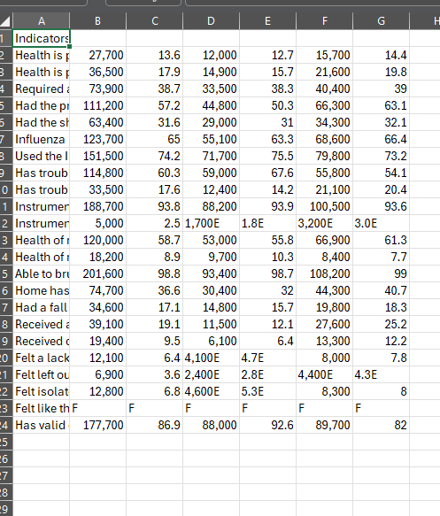
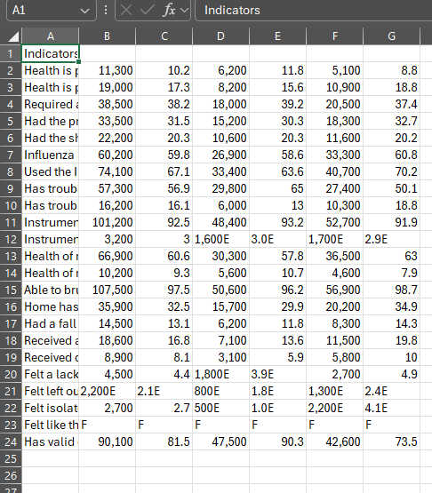
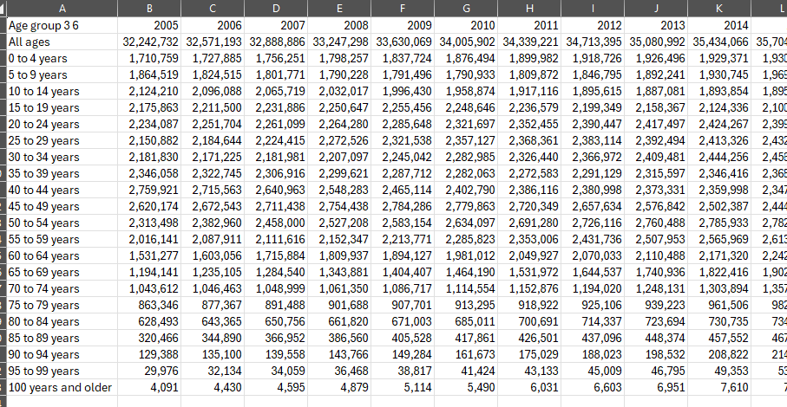
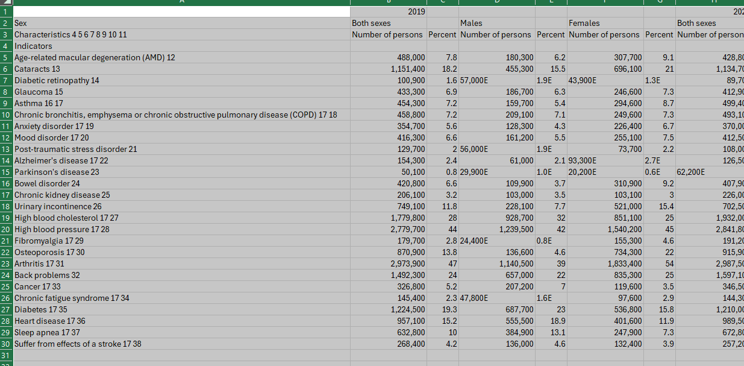
Raw Data
This project utilized multiple raw datasets from Statistics Canada (StatCan), covering:
Population by age groups across years (2000s–2024)
Health indicators by sex and age group
Chronic conditions in older adults
Residential care occupancy and workforce data across provinces
These datasets formed the foundation for our analysis in Jupyter and Power BI.

Slide 7
Jupyter Notebook -01
Initial cleaning of null values, duplicates, and formatting issues.
Used histograms, correlation matrix, and bar charts for pattern discovery.
Prepared features for machine learning and BI visualizations.
Visuals to include:
Heatmap showing feature correlation
Age group distribution
Bar chart comparing facility availability by region
Key Insight: Significant regional variation in support levels and elderly population growth requires targeted planning.
Html file: PivotNew

Slide 8
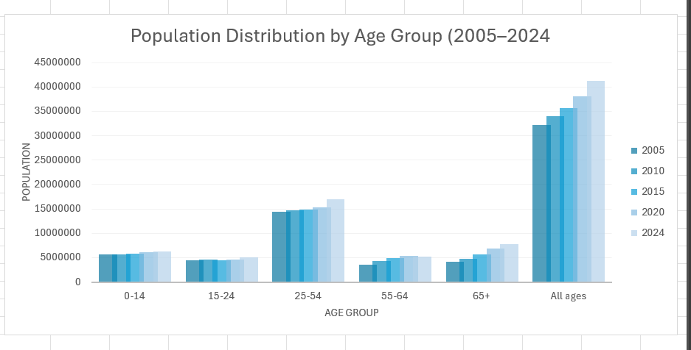
Pivot TABLE-01
65+ Age Group:
Shows the steepest growth over time.
Indicates an aging population — critical for your AI eldercare solution.
Population grows from under 5M (2005) to over 7M+ by 2024.
Overall Population Growth:
"All ages" bar shows a steady rise, crossing over 40 million by 2024.

Slide 9
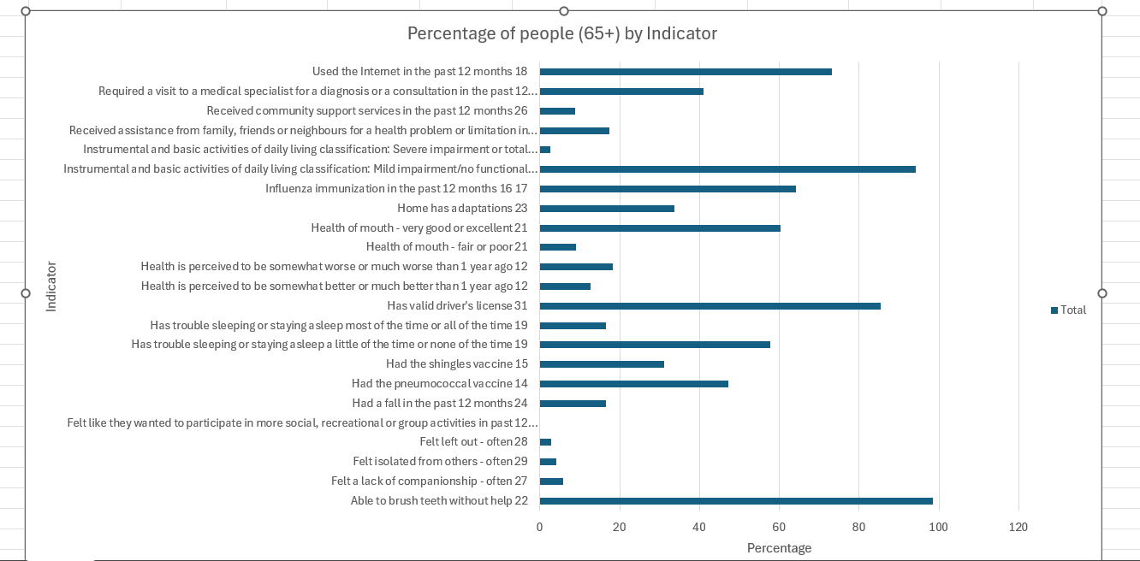
Pivot TABLE-02
This visual represents the percentage of seniors experiencing specific health or daily living challenges.
Over 95% of respondents report being able to brush teeth without help — but key support gaps are revealed:
31% hold a valid driver's license — suggesting reliance on others for mobility.
Over 23–26% had home adaptations or received community services — a signal of growing dependency.
24% reported falling in the past year — supporting the need for fall detection and alert systems.
17–21% report poor dental health, sleep troubles, or vaccine-preventable illness risks.
~28–29% felt isolated or lacked companionship — mental health is equally critical.
Around 75% of seniors show mild to severe functional impairments, needing physical or assistive support.

Slide 10
Jupyter notebook-02
Data Cleaning & Preprocessing
Removed ICD codes (e.g., [A00-Y89]) for cleaner cause labels.
Grouped similar causes into simplified categories (Cancer, Cardio, Respiratory, etc.).
Removed irrelevant or extremely rare causes.
Feature Engineering
Created new category: "Respiratory (All)" by summing multiple related causes.
Added Average_Deaths column to rank leading causes across years.
EDA Visualizations
Heatmap of Top 10 causes of death (2013–2023).
Line Chart of Top 5 causes (Cancer, Cardio, Respiratory, Dementia, Accidents).
Total Deaths Trendline from 2013 to 2023.
Predictive Modeling
Applied Linear Regression to each of the Top 5 causes to show long-term mortality trends.
Visualized both actual vs. trendline using dashed and solid lines for comparison.
Html files: JupyterNotebook03

Slide 11
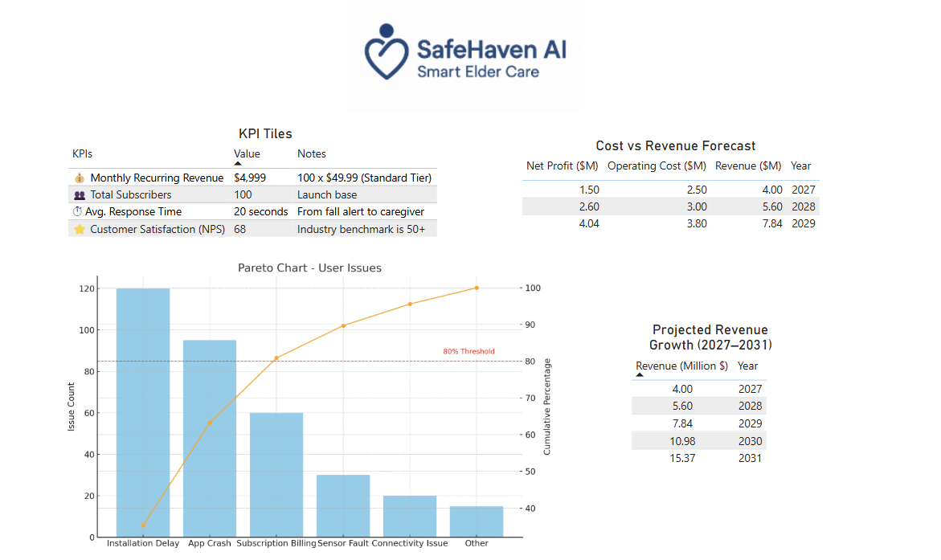
DASHBORD-01
User Pain Points: Pareto Chart Insights
Top Issues: Installation Delays, App Crashes, Billing Confusion
80% of user complaints stem from only three causes → highlighting priority areas for improvement.
Insight-driven UX improvements can significantly reduce support overhead and churn.
Projected Revenue Growth (2027–2031)
Revenue forecasted to grow from $4.0M (2027) to $15.37M (2031).
Growth strategy is backed by subscription expansion and low churn rate.
Predictive modeling supports consistent upward trend with conservative estimates.

Slide 12
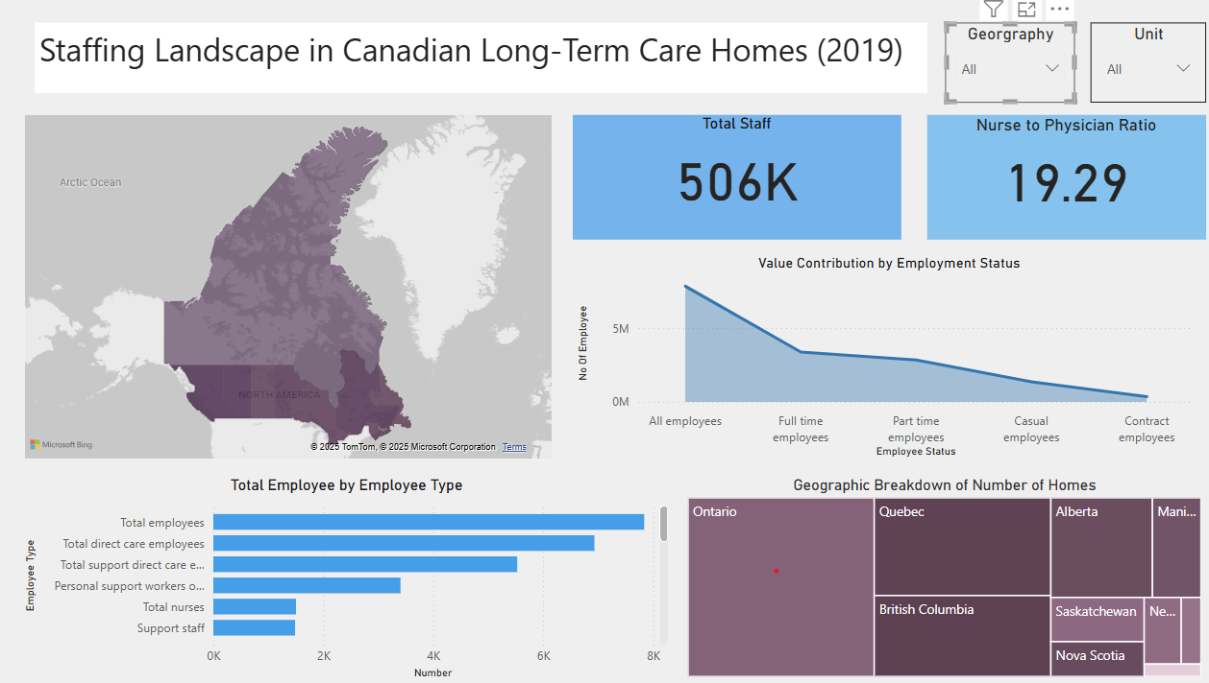
Dashbord-02

Slide 13
Dashboard-02
In 2019, Canada’s long-term care homes were supported by 506,000 total staff, including a diverse mix of care roles:
Direct care employees and support staff make up the majority of the workforce.
The nurse-to-physician ratio stands at 19.29, indicating a strong reliance on nursing professionals for day-to-day operations.
Employment Status Breakdown:
Most staff are full-time, while a significant number are part-time or casual, highlighting flexibility but also potential gaps in continuity of care.
Geographic Insights:
Ontario and Quebec lead in the number of care homes.
Provinces like New Brunswick and Manitoba show fewer facilities, signaling regional staffing based on the population.

Slide 14
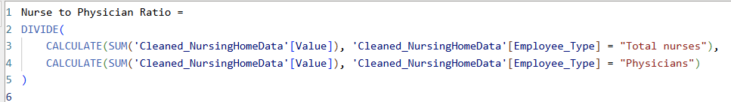
Dax measurements

Slide 15
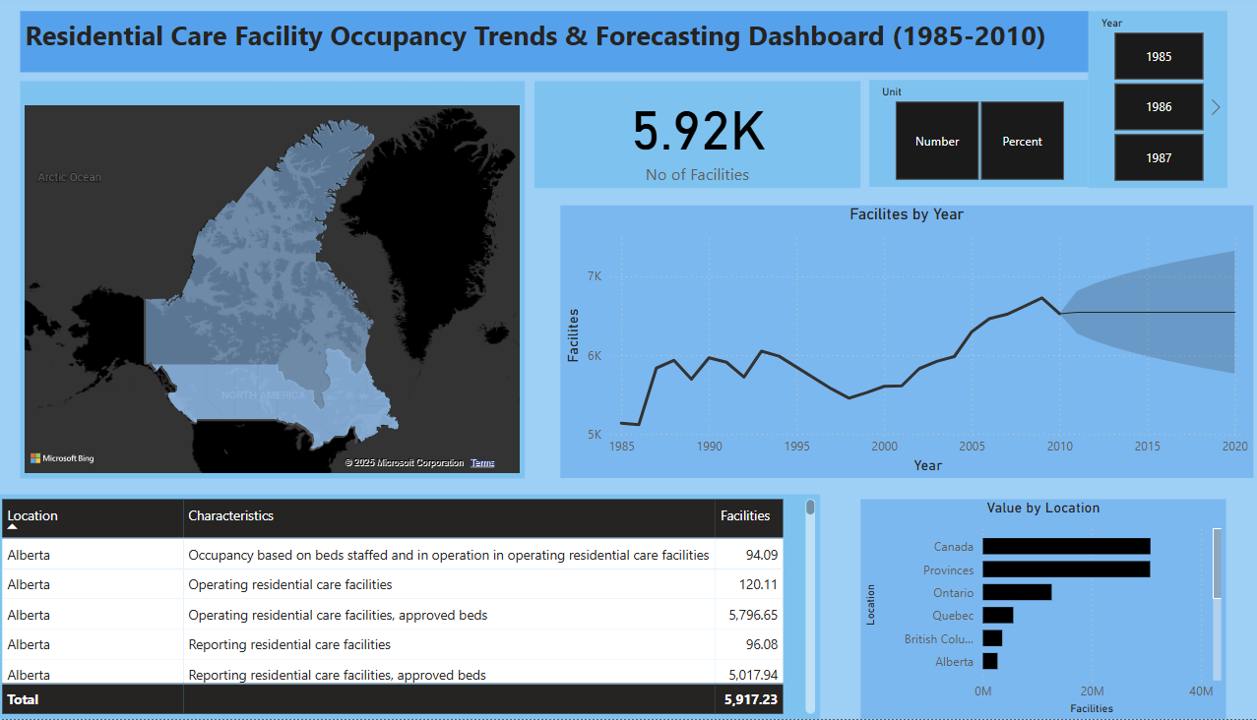
Dashboard -03

Slide 16
Dashboard -03
From 1985 to 2010, the number of residential care facilities in Canada increased from approximately 25k, reflecting growing demand driven by an aging population. The line chart shows steady growth through the 2000s, followed by projections extending to 2020 that highlight potential plateauing or need for policy intervention.
Most facilities are concentrated in Ontario, Quebec, and larger provinces, while smaller regions show lower capacity.
The dashboard includes detailed occupancy characteristics like staffed beds, operating status, and approved capacity.
This historical trend provides a foundation for forecasting future facility needs and planning for equitable care distribution across provinces.

Slide 17
How SafeHaven AI Will Implement the Solution?
Phase 1: Pilot Program (2025)
Partner with 5 long-term care homes in Ontario and British Columbia
Deploy fall detection sensors and train staff
Collect usage feedback and optimize the dashboard interface
Phase 2: National Expansion (2026–2027)
Expand to 50+ homes across provinces
Launch caregiver mobile app
Introduce bilingual support and in-home installation service
Phase 3: AI Chatbot & Predictive Features (2028 onward)
Integrate symptom monitoring and caregiver assistant chatbot
Use predictive analytics to prevent emergency incidents

Slide 18
Total Funding Requested: $90,000 CAD for phase 01
Phase 1: Pilot Program (2025) — $90,000
Item | Description | Estimated Cost
Hardware for 5 homes | Sensors, Wi-Fi devices, tablets | $25,000
Development | MVP of AI alert system + caregiver dashboard | $30,000
Staff Training | On-site + online tutorials for caregivers | $10,000
Data Storage & Hosting | Secure cloud infrastructure for 6 months | $5,000
Marketing & Pilot Outreach | Email campaigns, caregiver onboarding materials | $10,000
Legal & Compliance Setup | Privacy, health data, and vendor contracts | $10,000

Slide 19
Conclusion
Canada’s aging population is growing rapidly, yet long-term care homes remain under-equipped with modern monitoring and response systems.
SafeHaven AI bridges this gap by offering an intelligent fall detection and caregiver alert platform powered by data analysis, predictive modeling, and real-time dashboards.
Our data-driven insights show:
Rising occupancy trends and growing staff gaps in provinces populations but the need is still there.
High potential for digital interventions to improve both safety and efficiency in care homes.
Positive financial projections and customer feedback based on pilot assumptions.
Phase 1 Pilot Launch (2025) in 5 homes requires an estimated $90,000 CAD to prove feasibility and impact before scaling.
Backed by:
Power BI dashboards (staffing, facility trends, cost-revenue models)
Jupyter analysis (cause-of-death trends, forecasting, regression modeling)
KPIs and user issue tracking

Slide 20
References
Government of Canada. (n.d.). Core community supports to age in community. Employment and Social Development Canada. https://www.canada.ca/en/employment-social-development/corporate/seniors-forum-federal-provincial-territorial/core-community-supports.html
Statistics Canada. (2024). Table 17-10-0005-01: Population estimates on July 1st, by age and sex. https://www150.statcan.gc.ca/t1/tbl1/en/tv.action?pid=1710000501
Statistics Canada. (2024). Table 13-10-0789-01: Deaths and age-specific mortality rates, by selected grouped causes. https://www150.statcan.gc.ca/t1/tbl1/en/tv.action?pid=1310078901
Statistics Canada. (2024). Table 13-10-0849-01: Health characteristics, two-year period estimates, by age group and sex, Canada (excluding territories). https://www150.statcan.gc.ca/t1/tbl1/en/tv.action?pid=1310084901
Government of Canada. (2024). Seniors' health indicators dataset. Open Government Portal. https://open.canada.ca/data/en/dataset/095c3e0b-e825-4e4b-805e-e40ff763a198/resource/13077489-9c20-4395-afe4-1d84dd0f9cf7

Slide 21
References – Executive Dashboard
Growjo. (2023). Company profiles and growth insights. Retrieved from https://growjo.comBloomberg. (2022).
Vayyar Imaging raises $108M in Series E round, reaches $1B valuation. Retrieved from https://www.bloomberg.comLifeline Canada. (2023).
https://www.lifeline.caAltumView Systems Inc. (2023).
Sentinare smart activity sensor. Retrieved from https://altumview.ca
ConsumerAffairs. (2023). Elder care technology complaints and reviews. Retrieved from https://www.consumeraffairs.com
SaaS Capital. (2022). Monthly recurring revenue (MRR) benchmarks. Retrieved from https://www.saas-capital.com

Slide 22
Thank you
-Lakshya Patel

